Slide 1
NextHikes IT Solutions
Bike Sharing Demand Analysis Project Using Excel
by Harsimran Kaur

Slide 2
Project Overview
Bike Sharing Demand Analysis Project Using Excel
In order to ascertain when and why individuals rent bikes, this research uses Excel to assess the demand for bike sharing. After being merged into a single sheet, all of the data from various sources was verified for accuracy. To distinguish between weekdays and weekends, time of day, and total users, new columns were added. Patterns in rents by weather, time, and user type were discovered using pivot tables, algorithms, and charts. The project assists in demonstrating the busiest hours, the impact of weather on demand, and the distinctions between casual and registered users. Planning and decision-making in bike-sharing systems can be enhanced by the knowledge gained from this investigation.

Slide 3
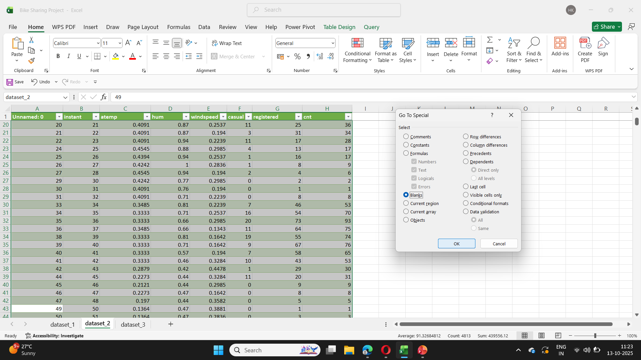
Step 1: Upload the all 3 datasheets into one workbook and do the preprocessing in all sheets one by one.
After the data has been uploaded, preprocess each datasheet individually. This includes resolving
missing values, eliminating duplicate values, adding columns, and deleting blank rows.

Slide 4
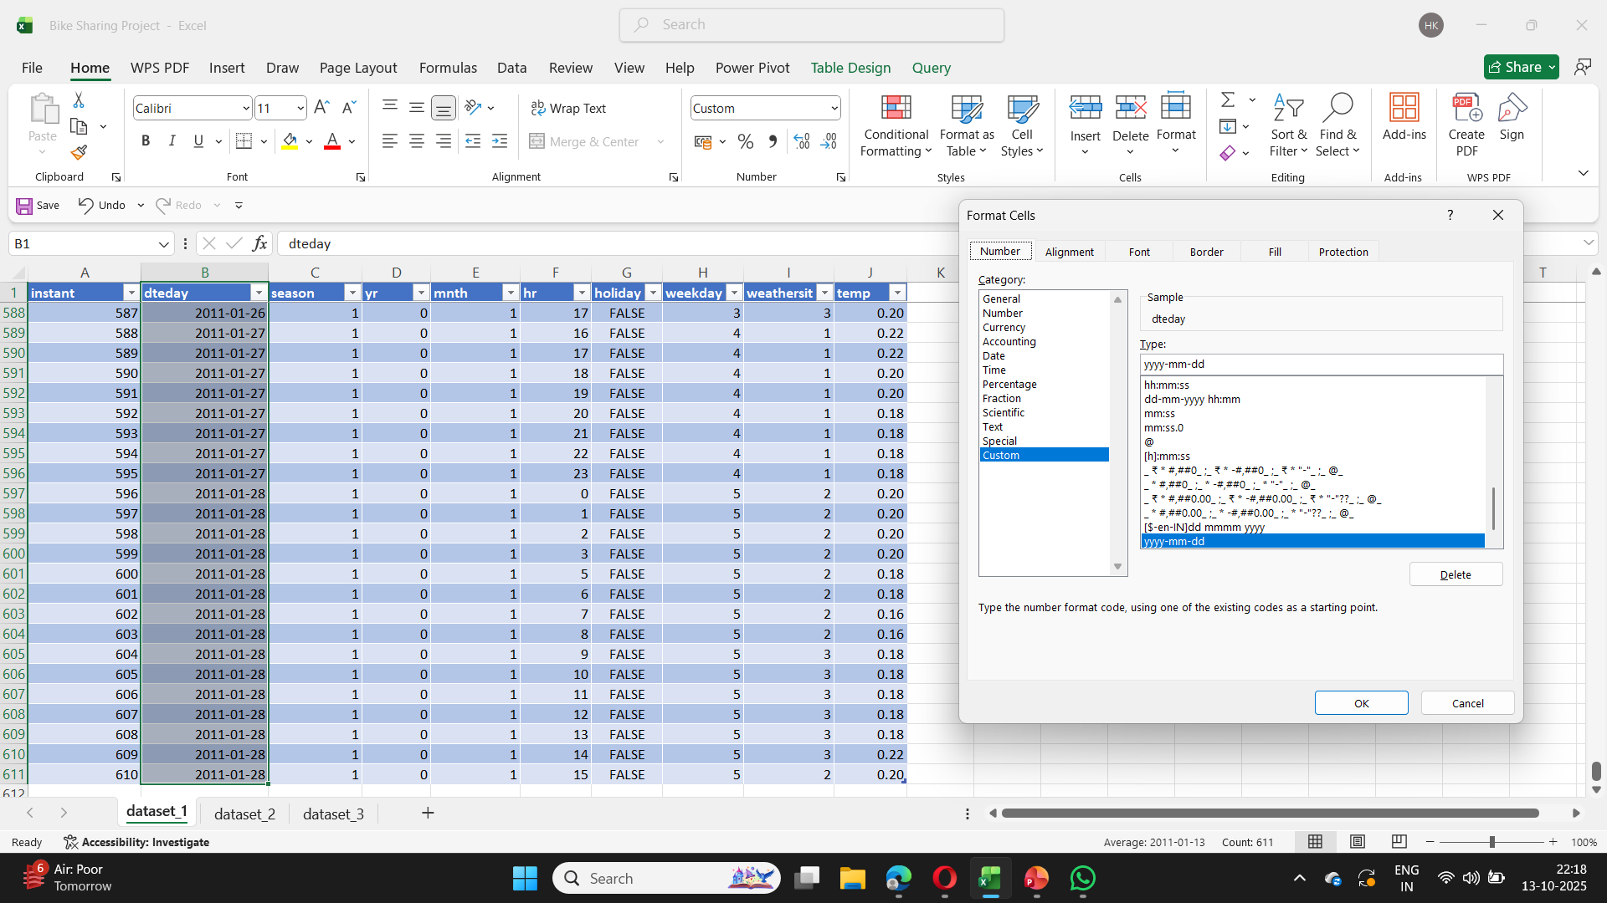
In this one we are doing the fixing the data types, changing the date format, trimming the spaces and repeat all the same process in other data sheets as well.

Slide 5
Step 2: After done with preprocessing now will merge dataset_1 and dataset_2.
Steps to Merge Datasheet1 and Datasheet2 in Power Query:
Open Power Query:
Go to the Data tab.
Click Get Data → Combine Queries → Merge.
Select Tables to Merge:
In the Merge window:
For the first table, select Datasheet1.
For the second table, select Datasheet2.
Choose Matching Columns:
Click the column in Datasheet1 that you want to match on
Then click the matching column in Datasheet2.
Make sure both columns are highlighted.
Choose Join Type:
Use Left Outer Join if you want to keep all rows from Datasheet1.
Or Inner Join if you only want rows that exist in both.

Slide 6
Steps to Merge dataset_1 and dataset_2 in Power Query:
1. Go to the “Data” tab in Excel.
2. Click on “Get Data” → Combine Queries → Merge.
3. The Merge window will open:
For the first table, select dataset_1.
For the second table, select dataset_2.
4. Now select the common column between them You must click the same column in both datasets. 5. Choose the Join Kind 6. Click OK. After the Merge:
1. A new column with a Table link will appear. Click the expand icon (🔽) in the header of that column.
2. Select the columns from dataset_2 you want to bring in.
3. Click OK to expand.
Final Step:
Go to Home → Click Close & Load To…
Choose how you want to load the merged data

Slide 7
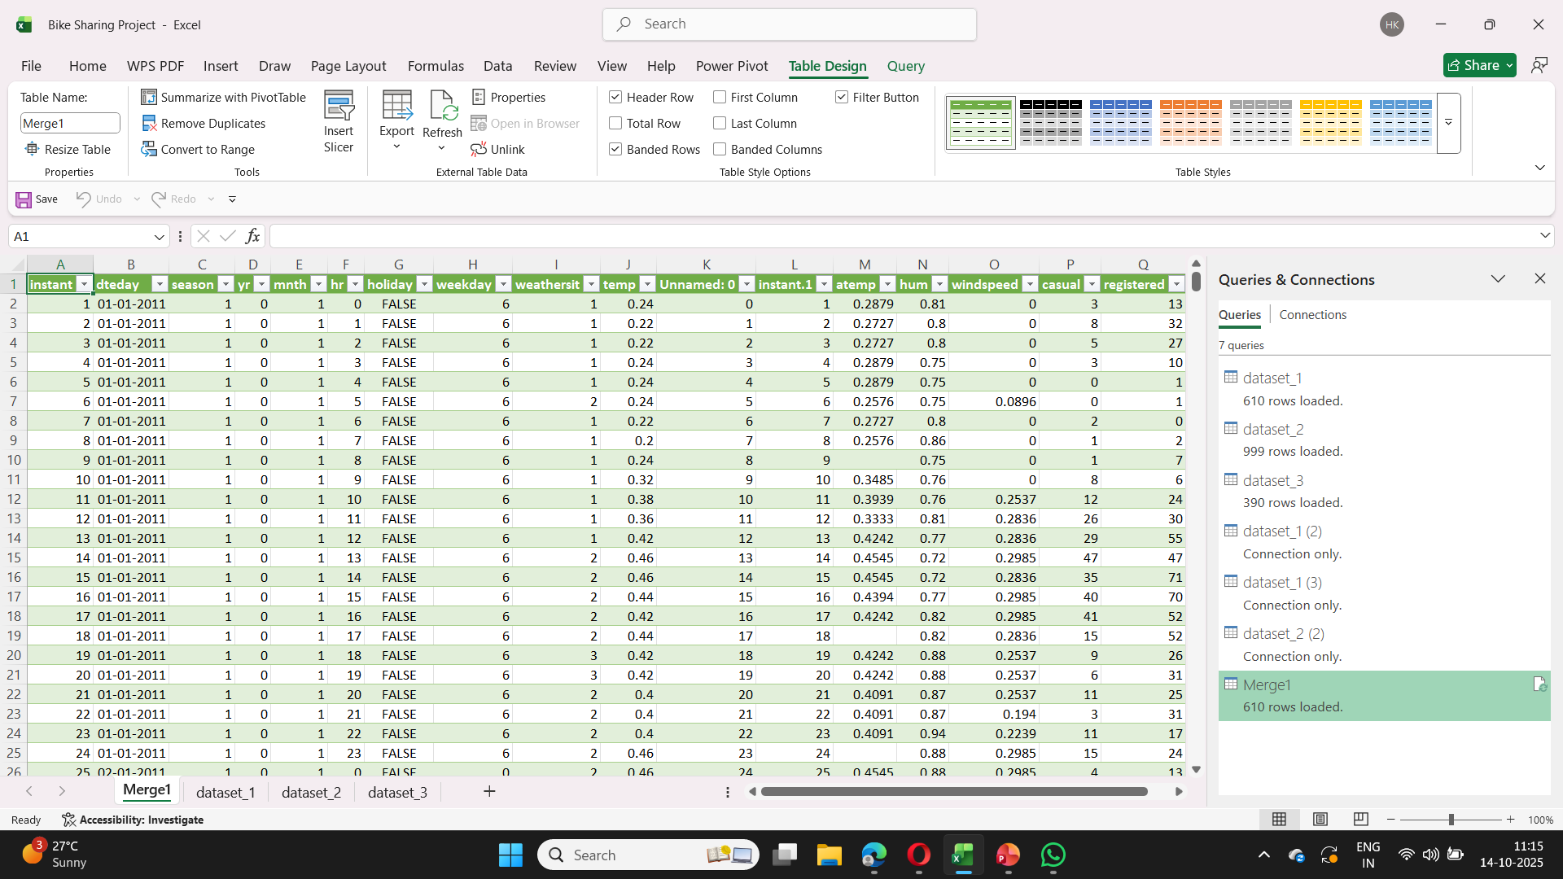
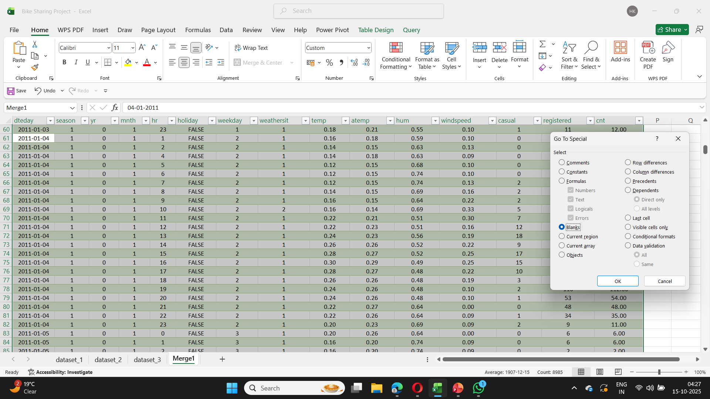
Step 3: After merging data then do the preprocessing of the merged data.

Slide 8
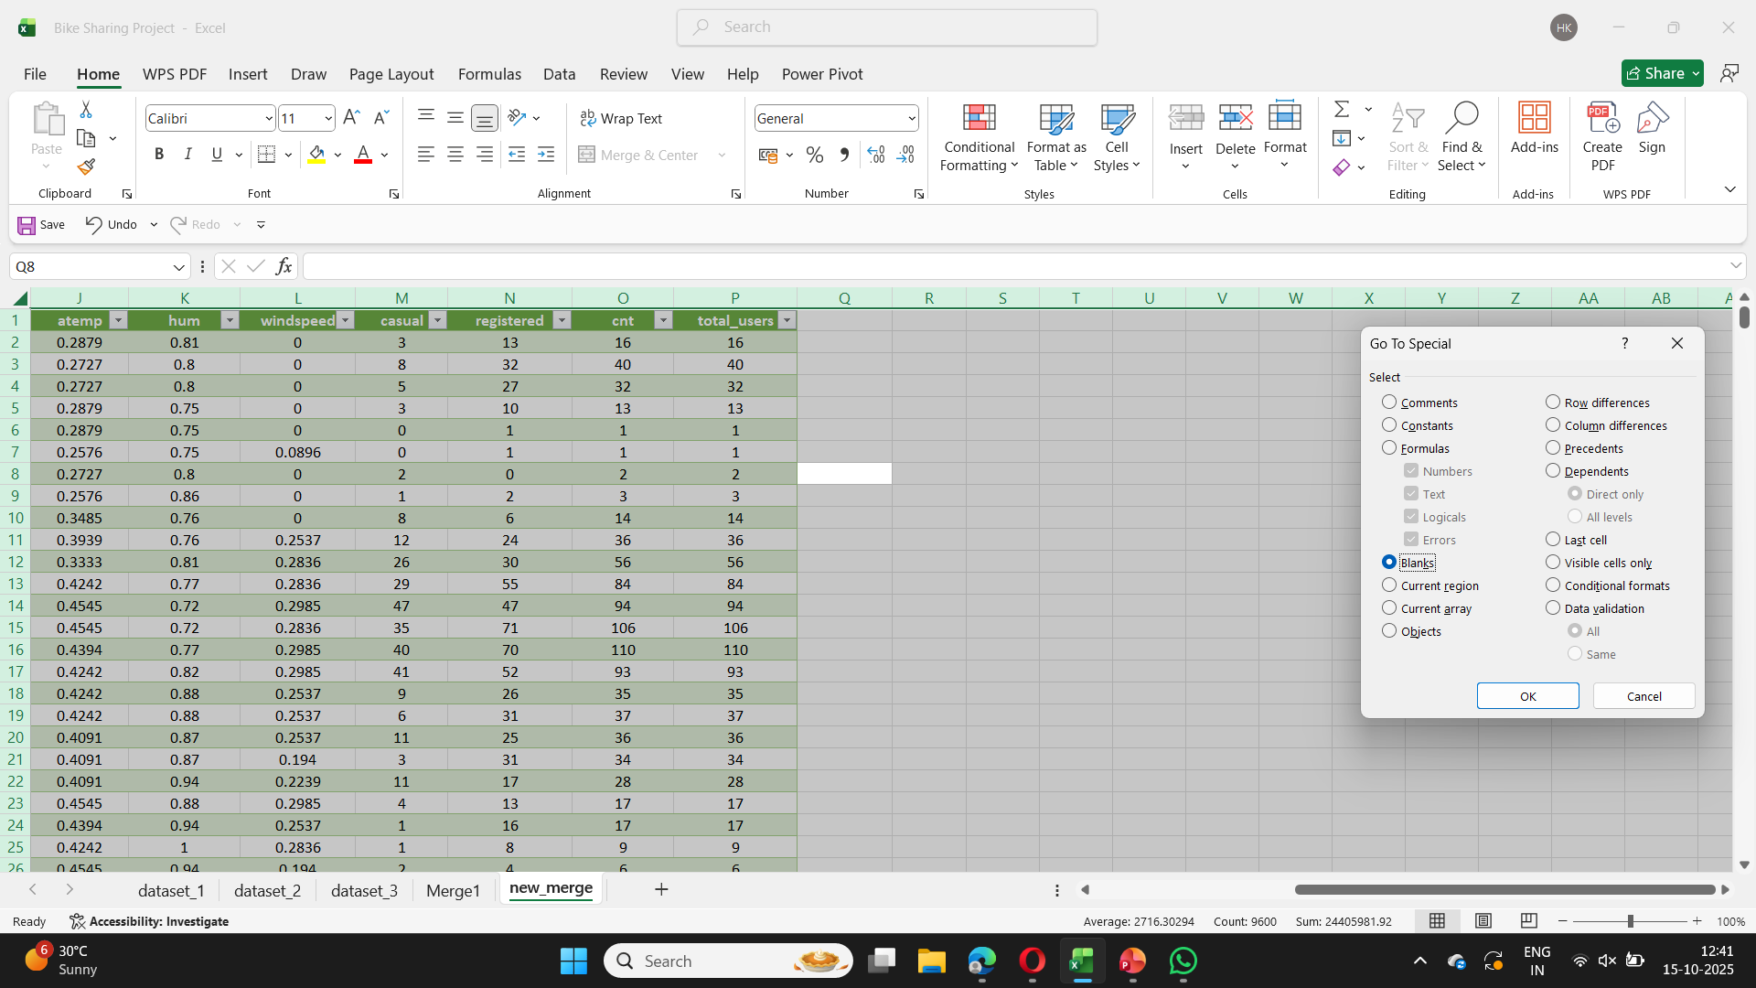
. Step 4:Now merge the dataset_3 and merge1 to get the new data on which we are going to work further.
Here I have done preprocessing of new_merge sheet by removing duplicates, set the data type and making new column.

Slide 9
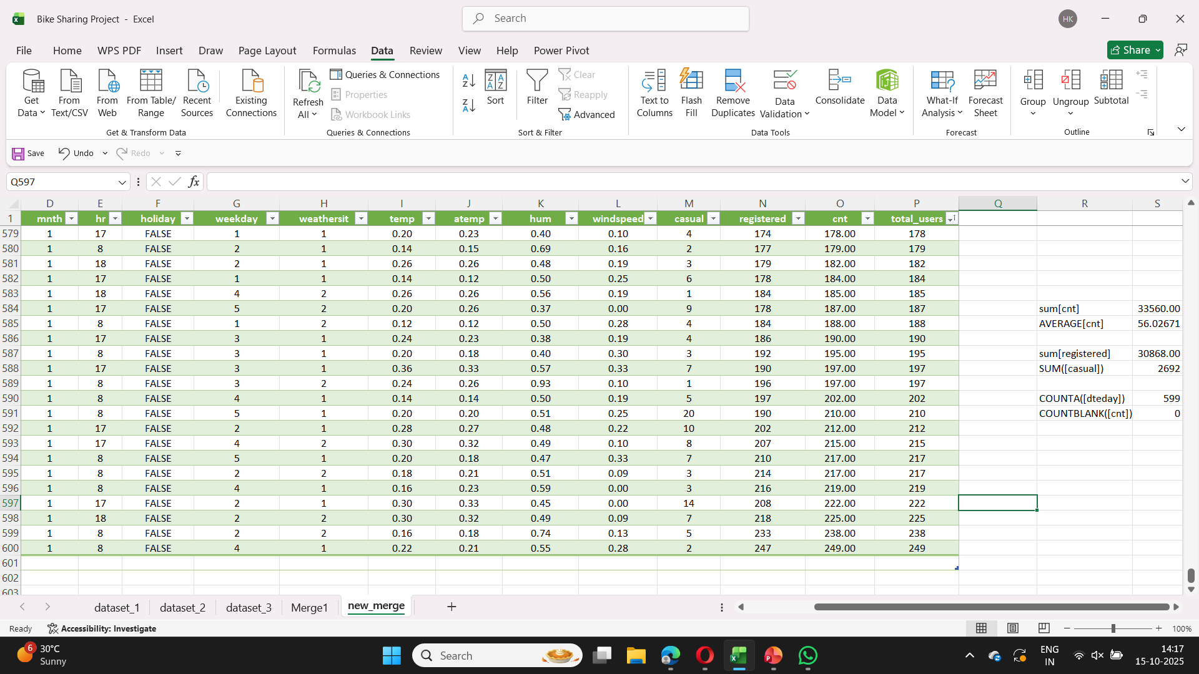
Step 5: Now after doing data sorting , filtering apply some basic formulas for example SUM,AVERAGE,COUNT.
Using =SUM(Merge4[cnt]) to get Total rentals (cnt)
Using =AVERAGE(Merge4[cnt]) to Average rentals
Using =COUNTA(Merge4[dteday]) to Count of rows (how many records)

Slide 10
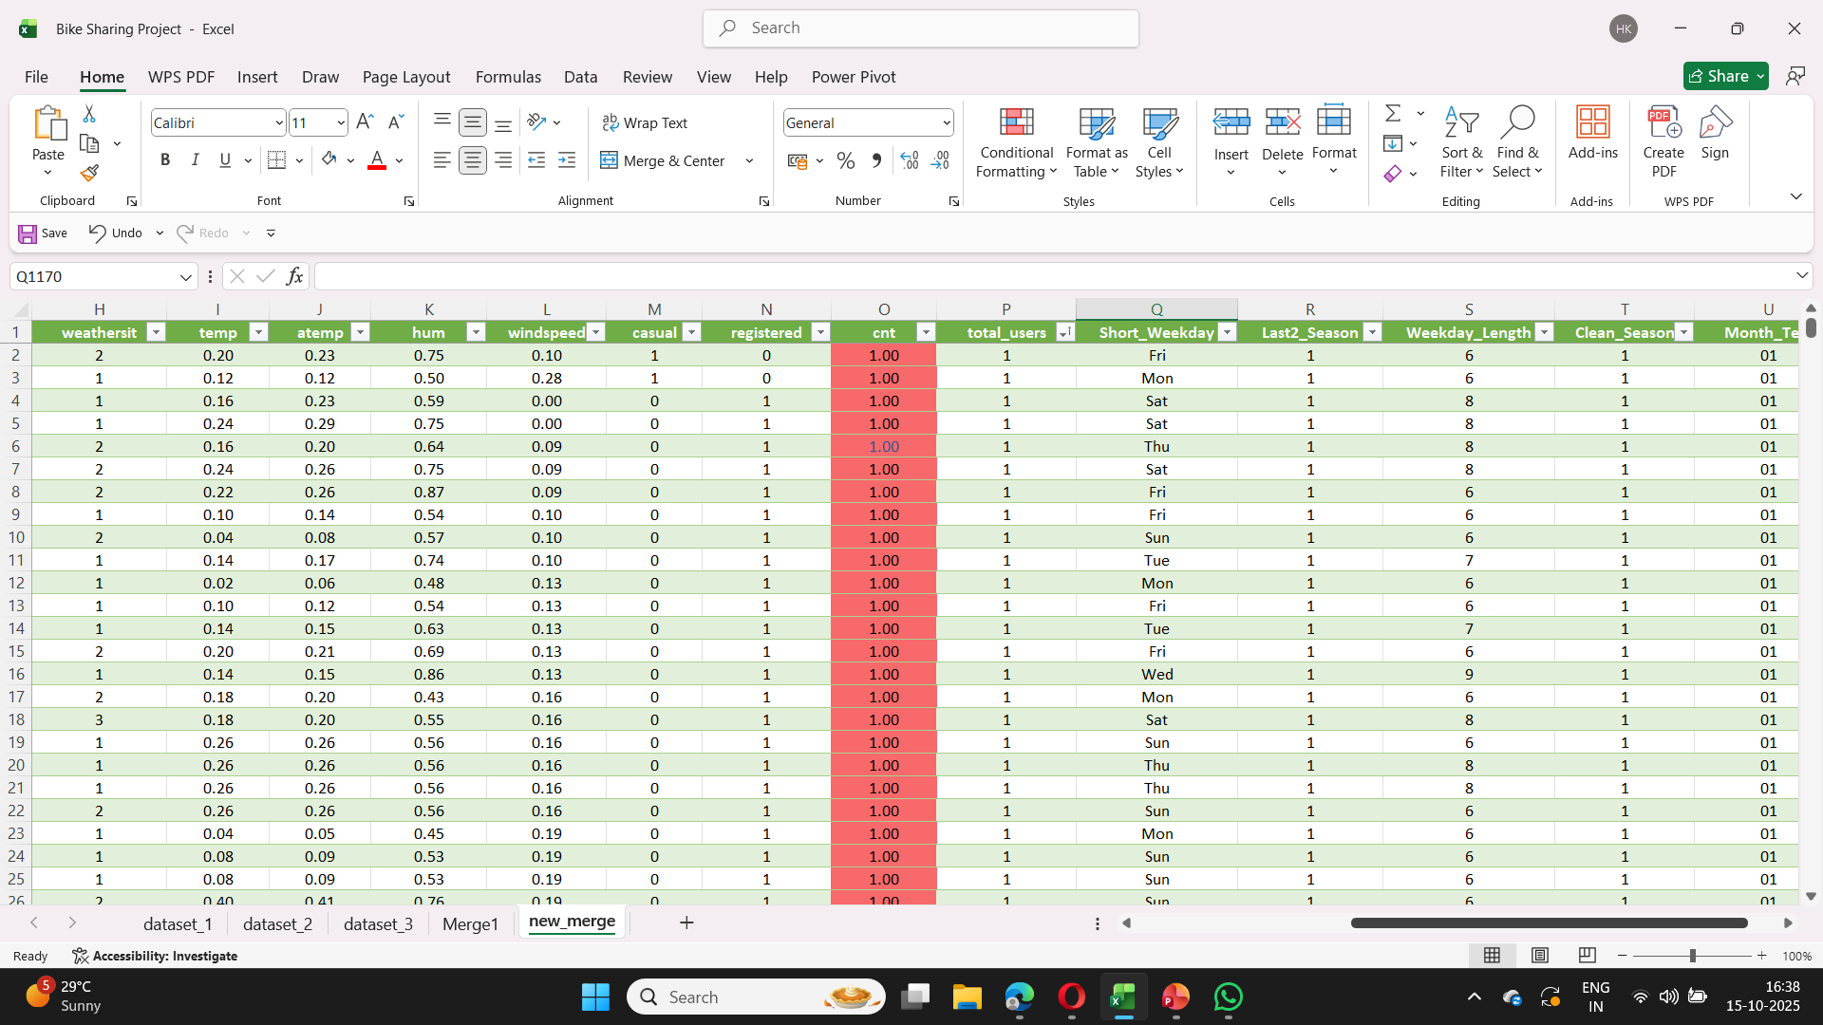
Step 6: Now we are going to use some functions like SUM / AVERAGE / COUNT and add few new columns, which is Short_Weekday, Weekday_Length etc.
Here using power query, we do some conditional formatting on cnt column Green = High rentals, Red = Low rentals

Slide 11
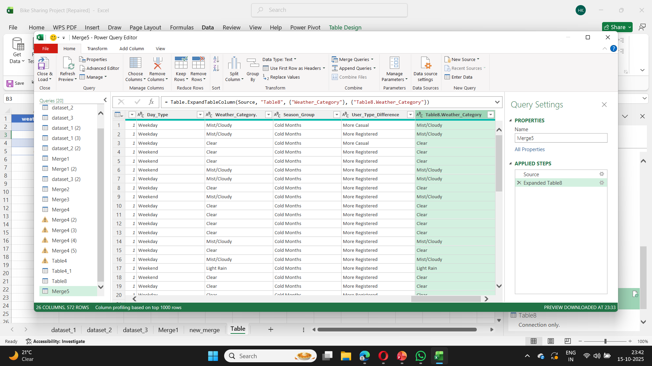
Step 7: Here we did Conditional Logic and Lookup function using power query. We make four new columns by adding columns and doing conditional formatting.
Here we did VLOOKUP in power query by merging two tables. First, we upload those tables in power query then merge it together. And then extract the table as well.

Slide 12
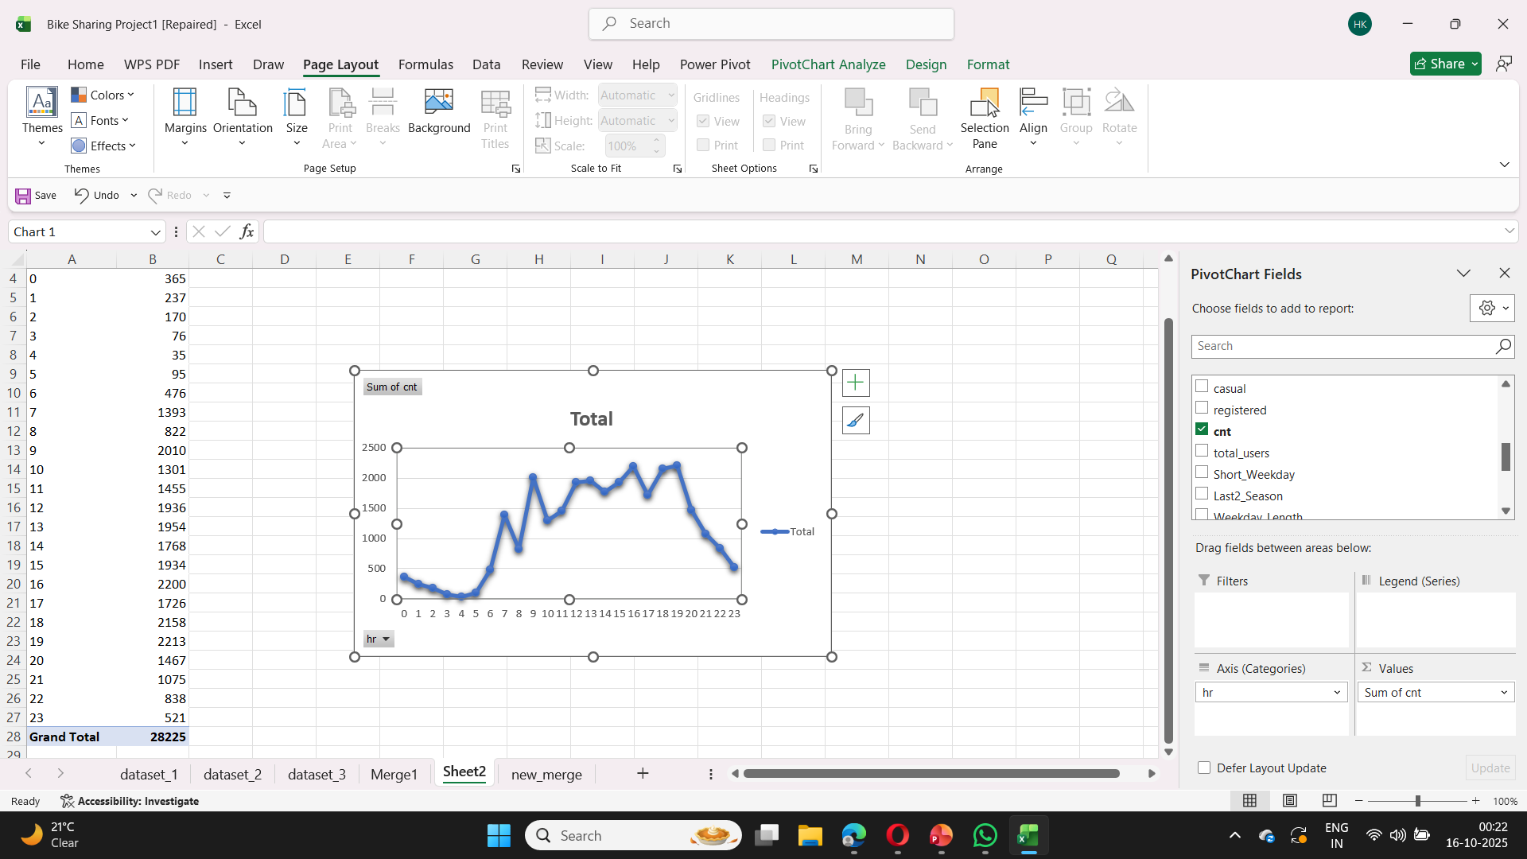
Step 8: Now make a Pivot Chart by :- Drag hr to Rows. Drag cnt to Values.
By default, Values shows Sum of cnt → that’s total rentals by hour.

Slide 13
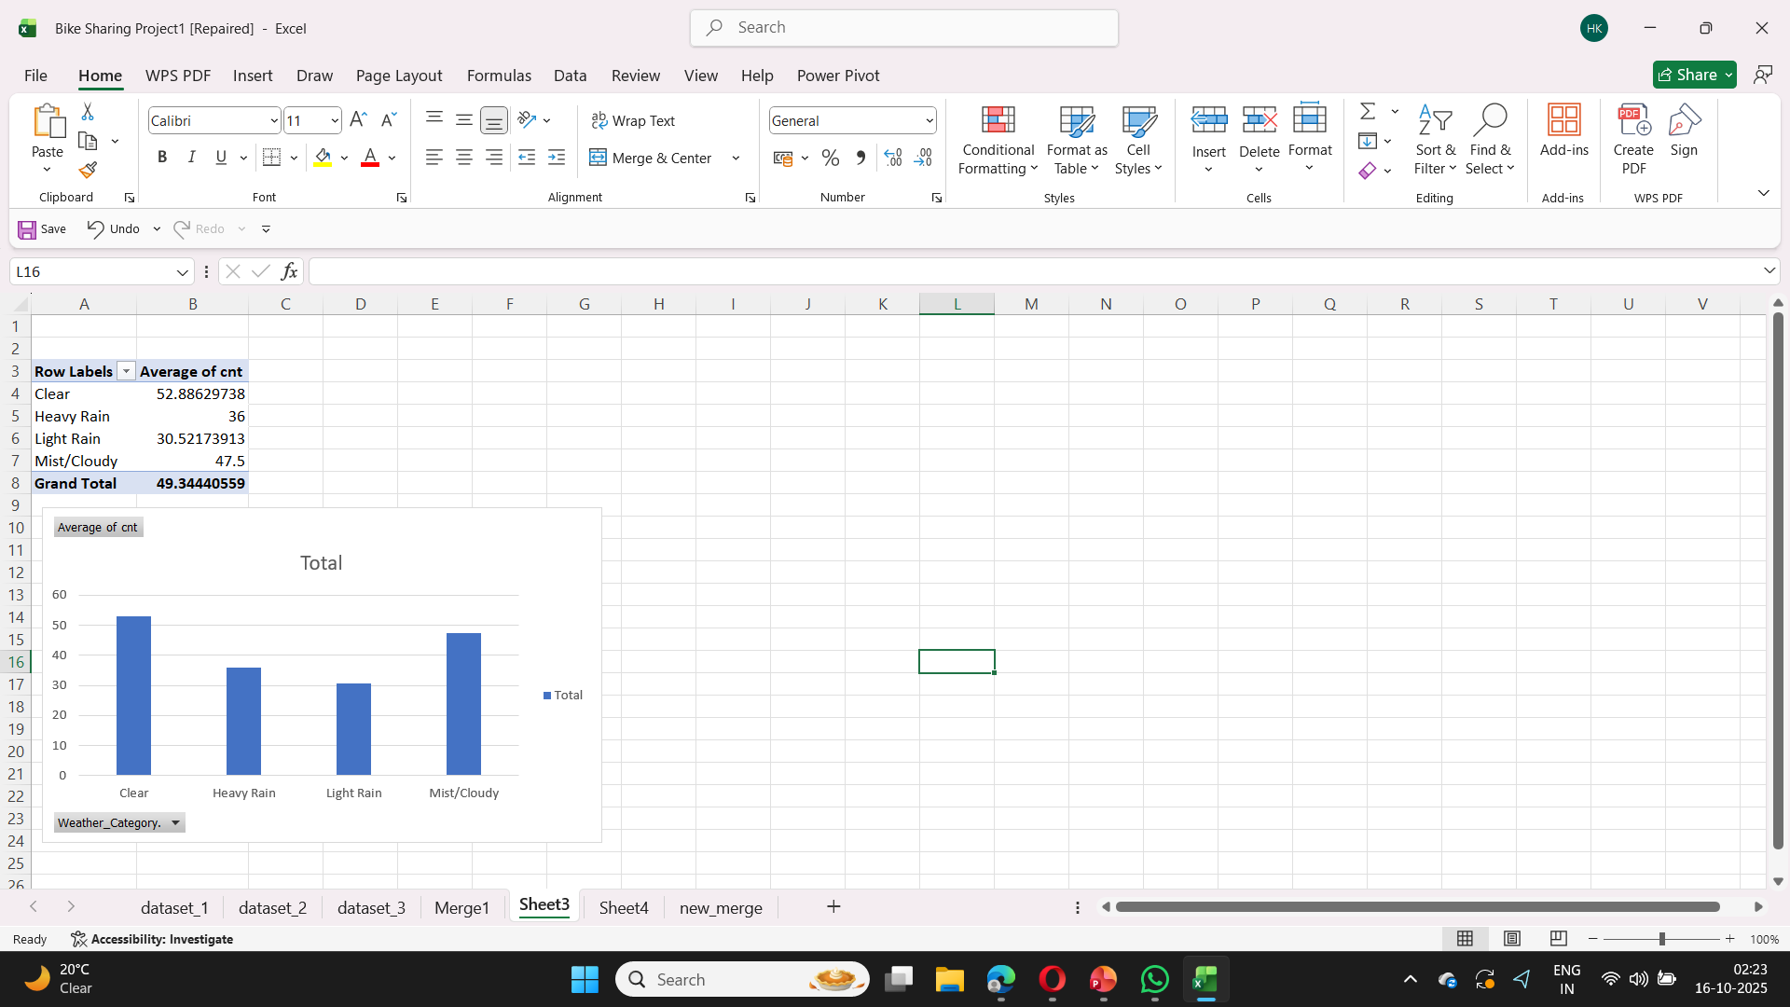
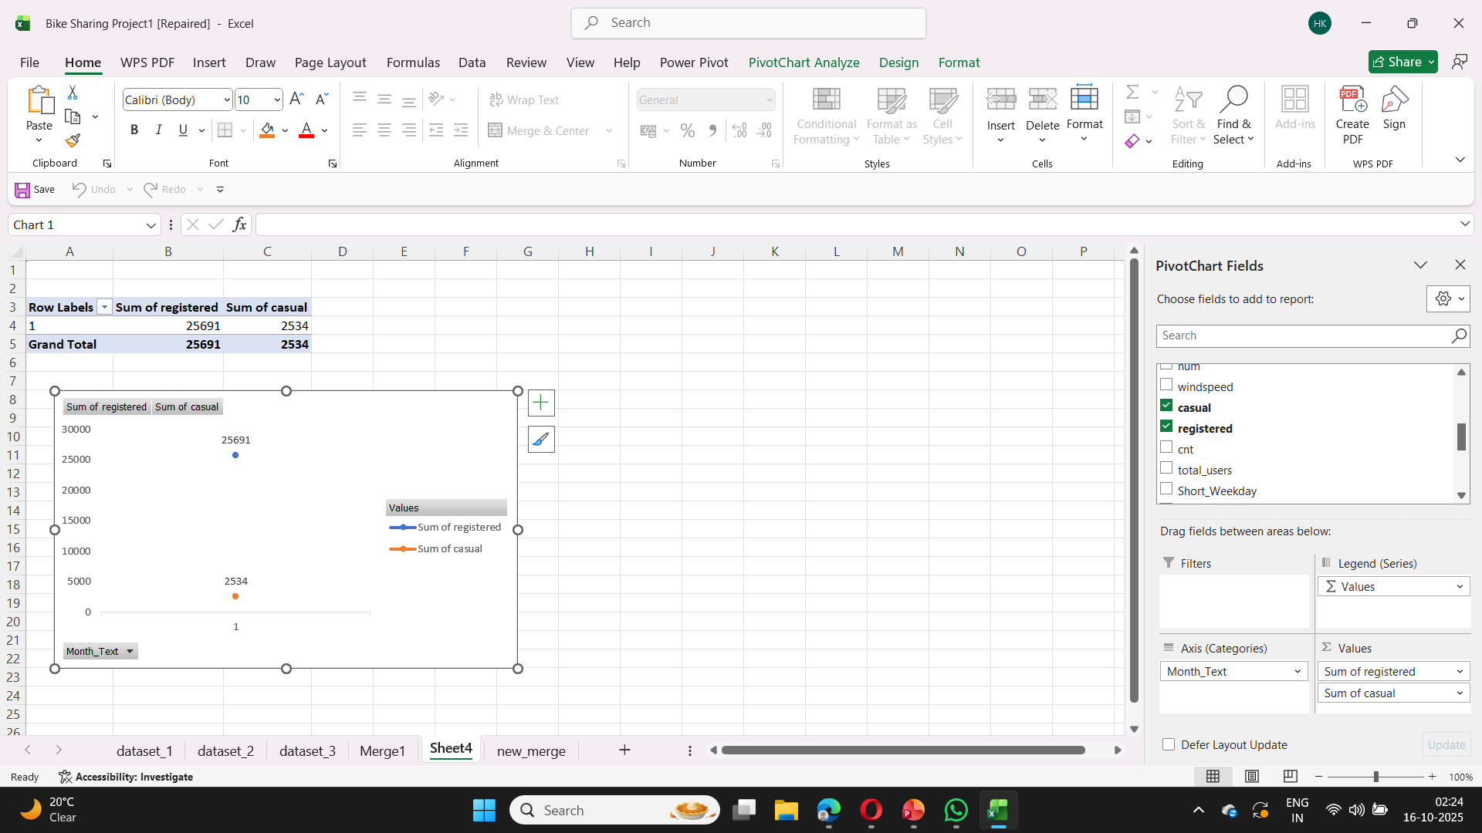
Step 8: Here we Summarize demand by Weather / User type.
1. Rentals by weather: In the Pivot Fields:
Drag Weather_Category to Rows.
Drag cnt to Values (Sum or Average).
2 — Registered vs Casual by Month:
Drag Month_Text to Rows
Drag registered and casual both to Values

Slide 14
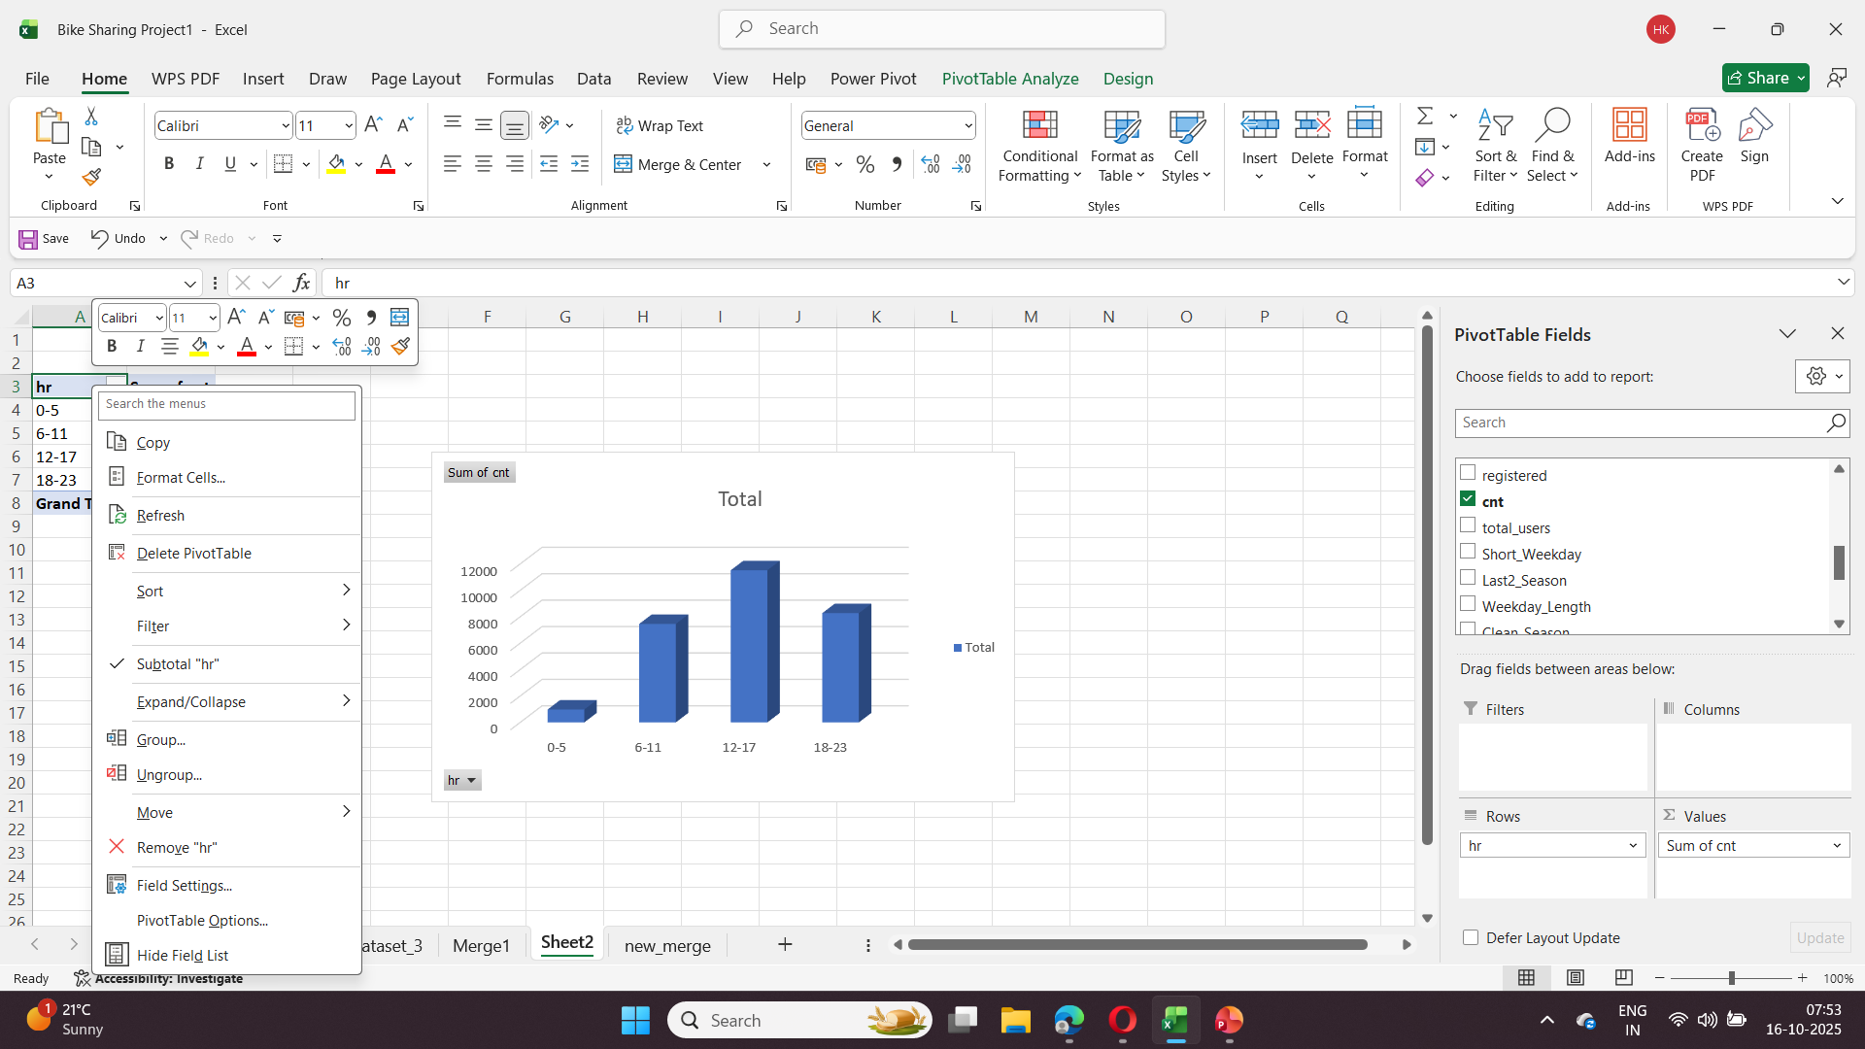
Step 9: Here we make a pivot table and chart by summarize user demand based on time.
Grouping and aggregating data with taking hr in rows and cnt in values.

Slide 15
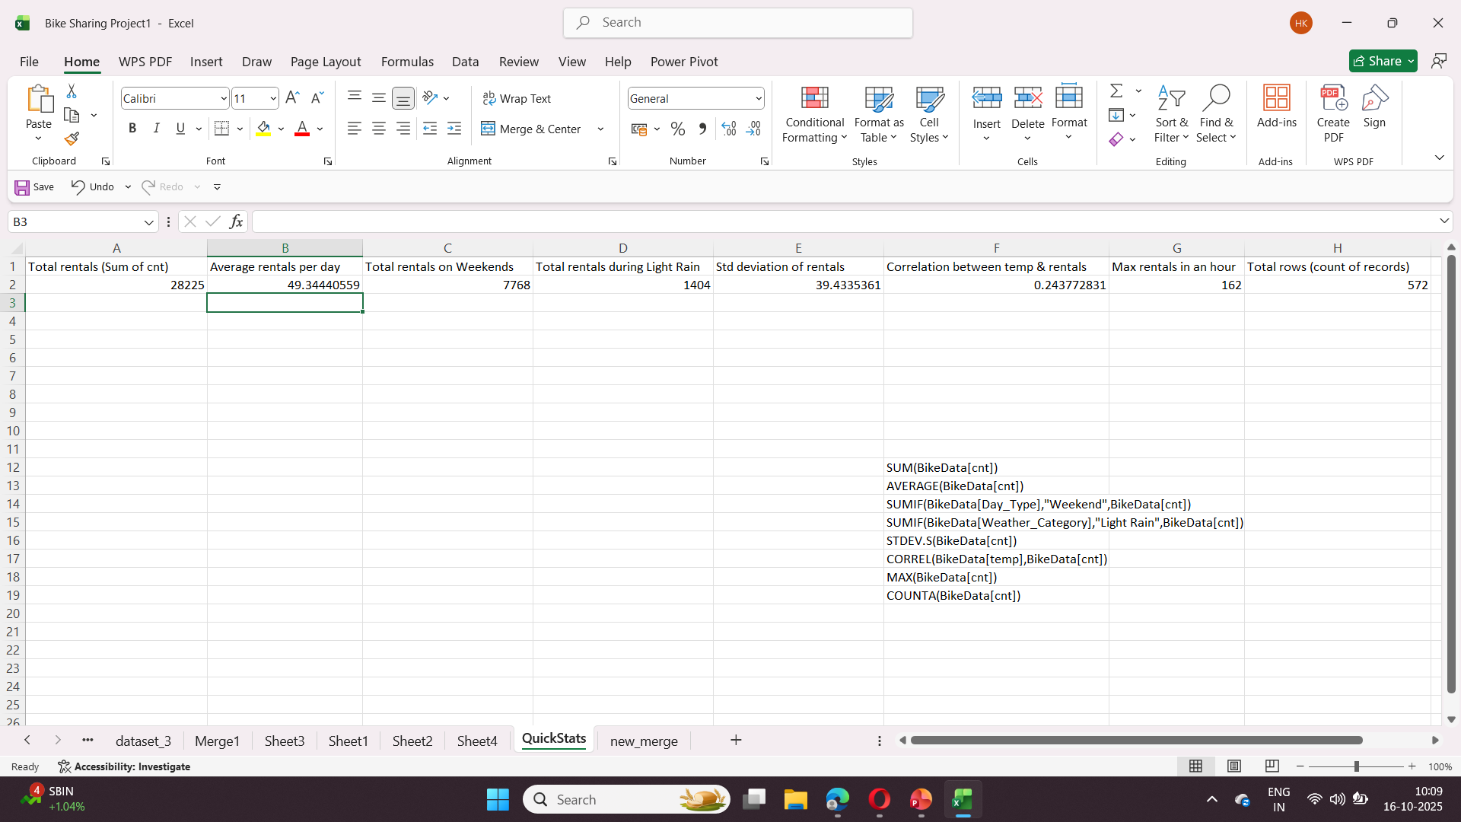
Step 10: Here we make a new sheet name QuickStats in which we do some statics function using BikeData Table.
We use COUNTIF, SUMIF, STDEV, CORREL functions for statistics.

Slide 16
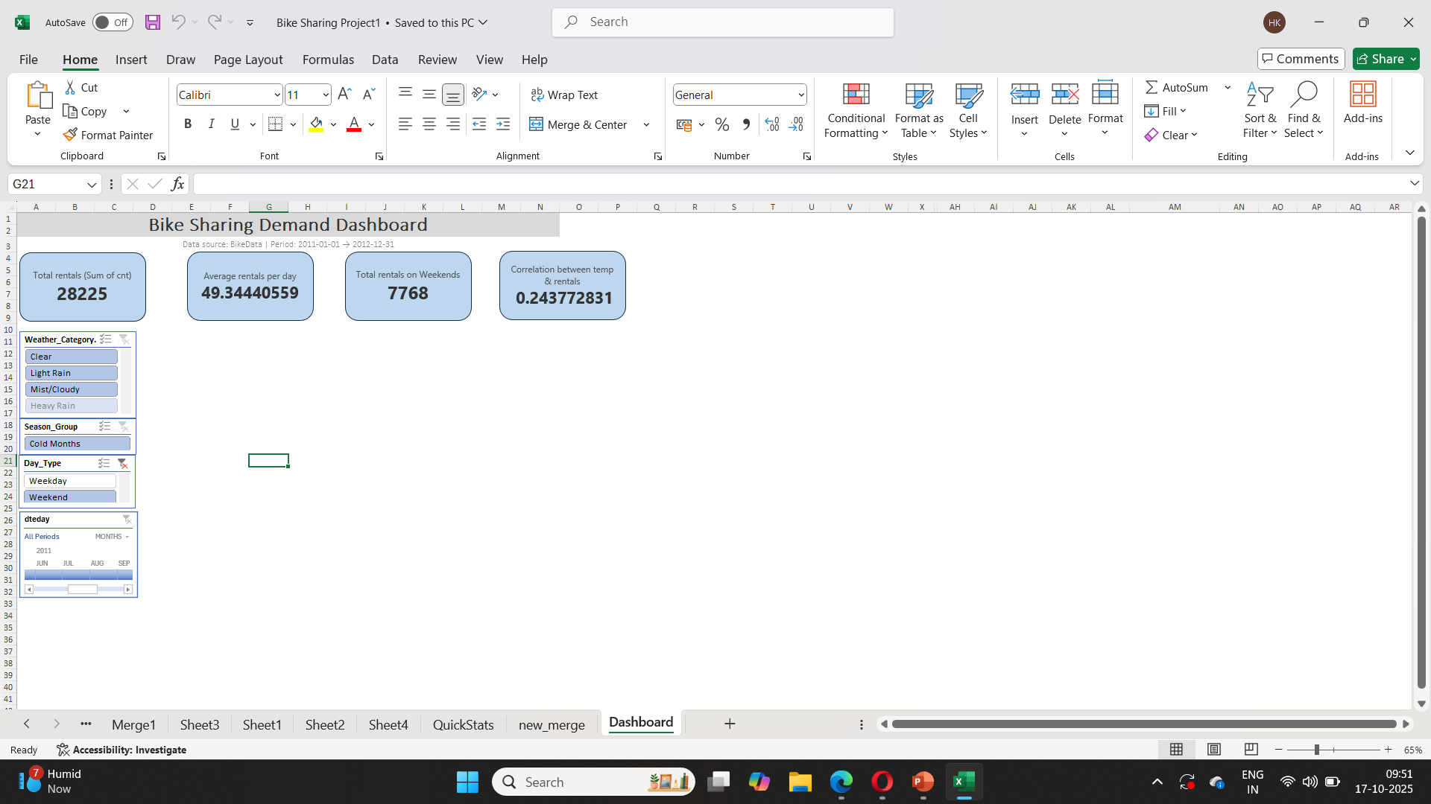
Step 11: After this we will start making dashboard by using all the pivot charts adding slicer and timeline

Slide 17
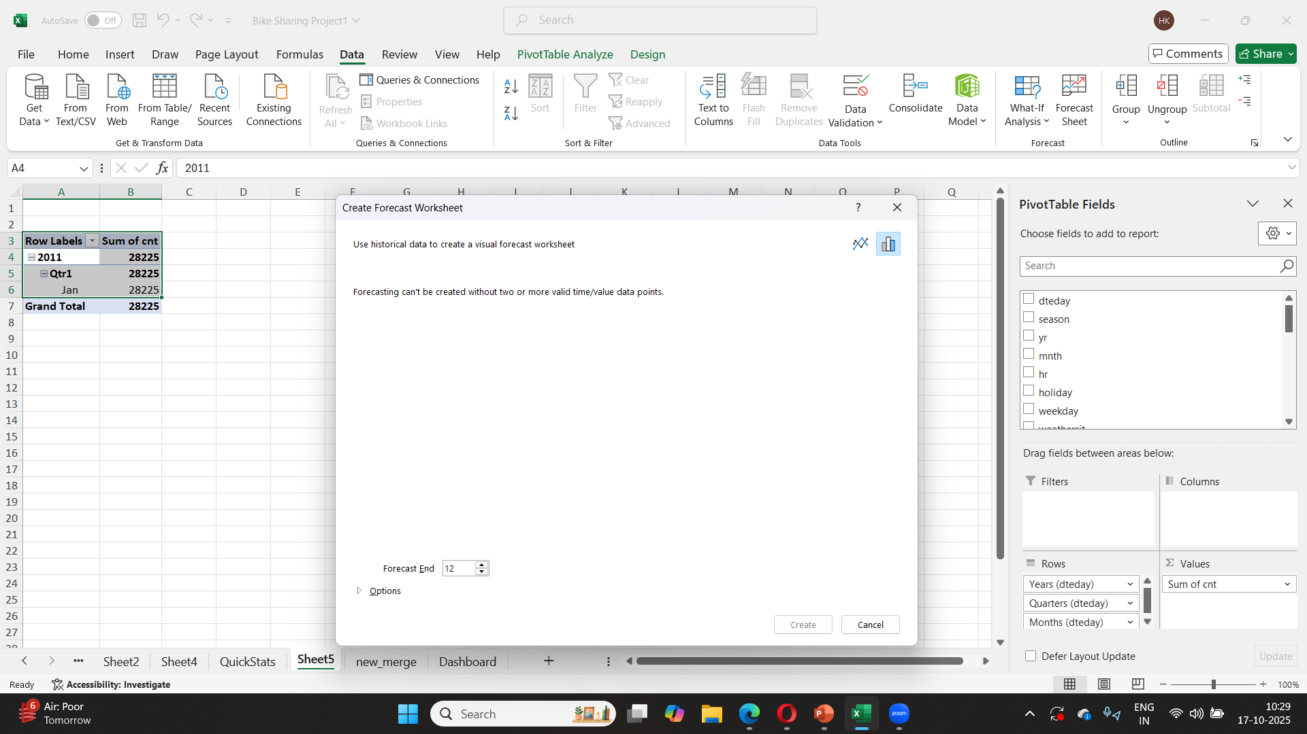
Step 17: Next, we add a Forecast Sheet

Slide 18
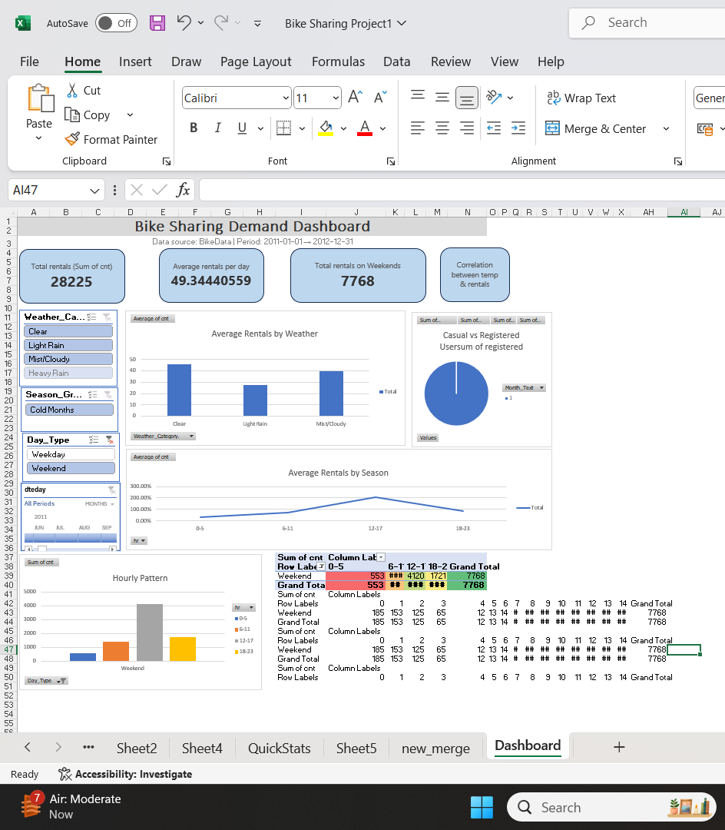
Step 13: Final Dashboard

Slide 19
SUMMARY
Excel is used in the Bike Sharing Demand Analysis project to investigate rental trends. It is evident from KPIs, PivotTables, and an interactive dashboard that the demand for bikes is greatest in the summer and lowest in the winter. Rainy days result in a large decrease in rentals, while clear weather stimulates more rides. Commuter peaks occur between 8 AM and 6 PM, according to hourly averages, and most rides are taken by registered users. All things considered, the dashboard offers lucid, data-driven insights to comprehend and prepare for demands for bike sharing that vary according to the seasons and the weather.

Slide 20
THANK YOU

